Slide 1
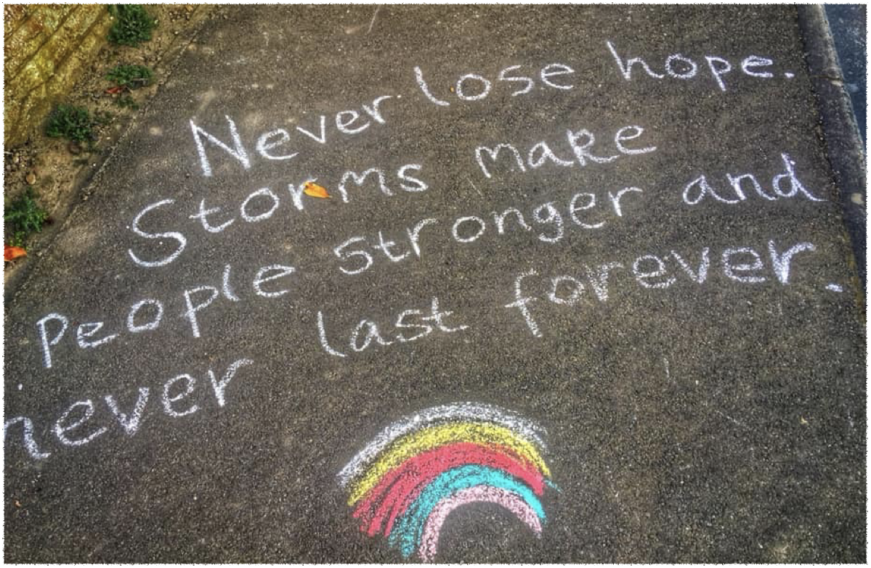
My Reflective Diary

Slide 3
What should my reflective diary look like?
Yours will be unique! We will be reflecting on some common core values. You will find something on each page which will provide stimulus for your creative thinking. It may be a photograph, quote, poem or piece of art. There will be a few questions to get you started.

Slide 4

Getting started
What you’ll need:
Access to the daily reflection diary materials online
A space where you can think
A note pad, art pad or blank document where you can enter text, images and your own digital doodles/art
Drawing/writing/painting supplies
You may want to look things up on the internet too, such as quotes, artwork, stories and facts, etc.

Slide 5
First things first...
Take a good look at the daily reflection
Give yourself a while to think about it:
What do you think? How does it make you feel? (it’s okay to disagree or have alternative views).
How would you like to respond?

Slide 7
Core Christian Values
Explored in this Reflective Space
Trust
Friendship
Forgiveness
Determination
Respect

Slide 8
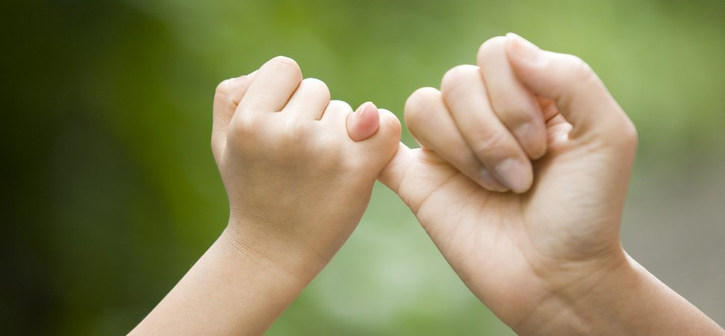
Trust

Slide 9
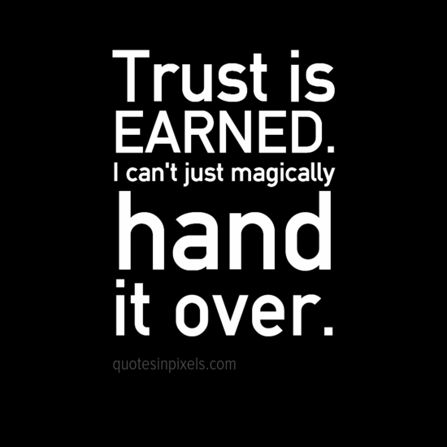
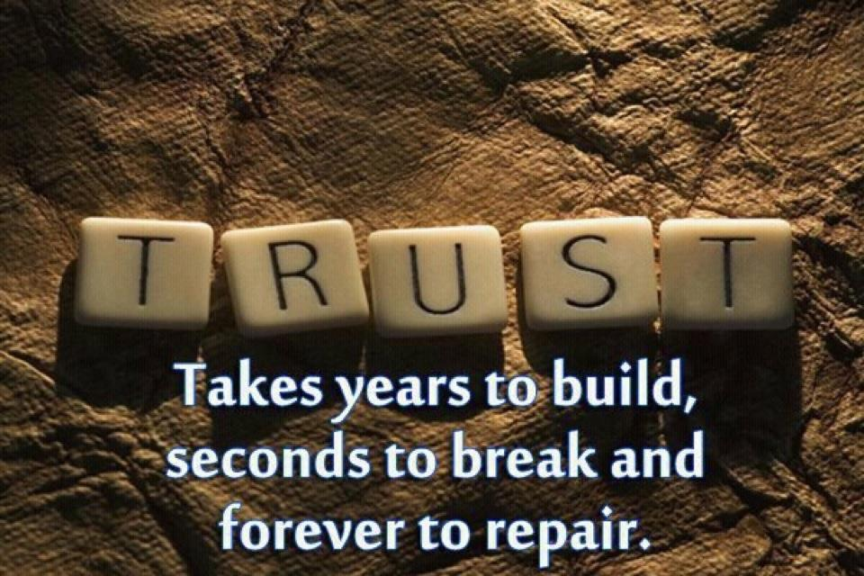
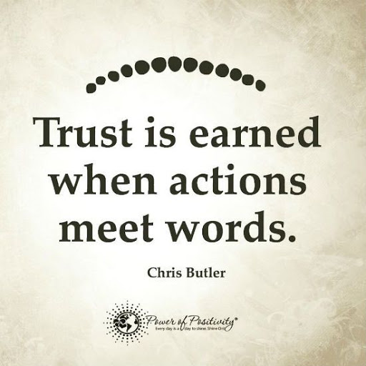
Trust
Read and think about these quotes about trust. Do you agree or disagree with them? What do you think they are trying to say? How do they make you feel?
Choose your favourite trust quote from these or from another you find. Write it in your reflective diary and illustrate it.

Slide 10
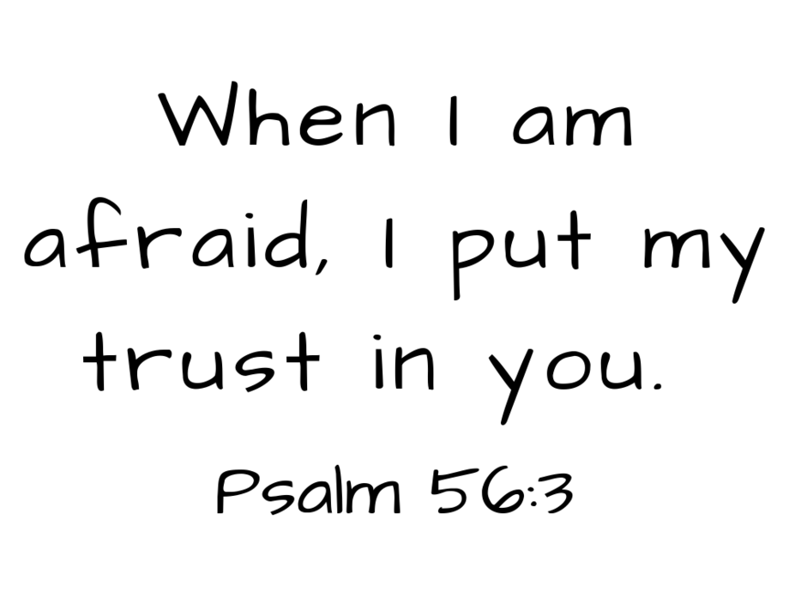
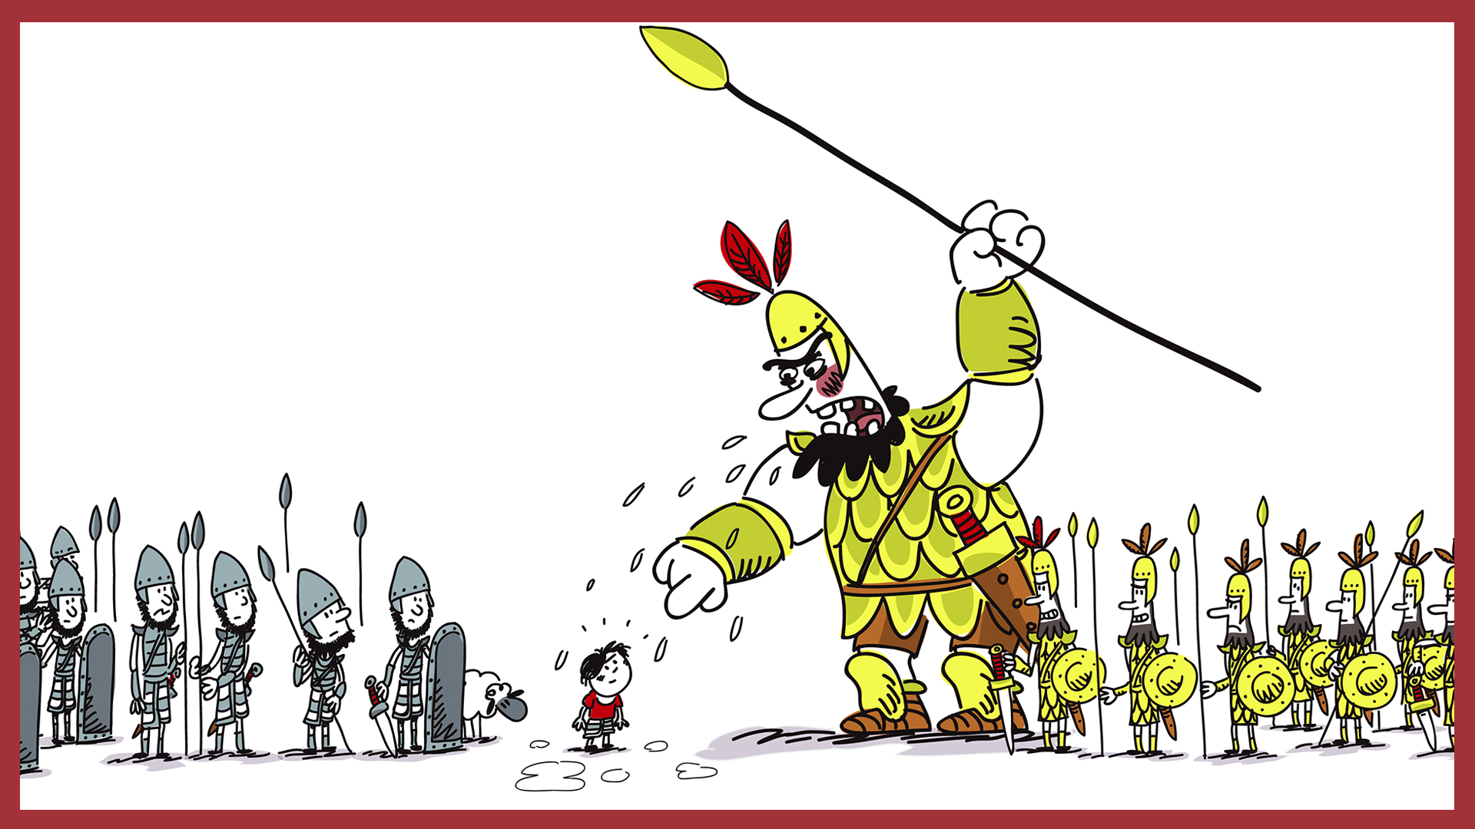
Trust
These are the words of King David from the Old Testament in the Bible. When David was a young boy he trusted God to help him defeat the fierce giant, Goliath.
Who do you trust, and why? (There might be more than one person!)
Why do you think David put his trust in God?
Can people trust you?
Do you think trust is an important value?
Watch this clip to find out more about David and Goliath https://youtu.be/OrZOWjfoMH8

Slide 11
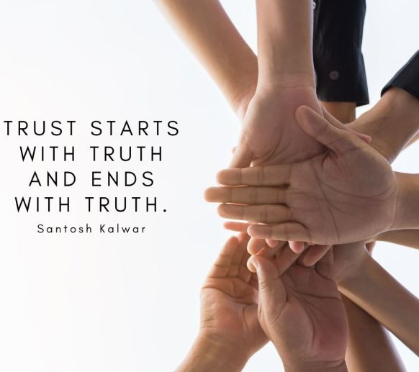
Trust
Read this quote. Do you believe that truth is an important ingredient for trust?
Watch the video clip of the story of the boy who cried wolf
Why do you think no-one trusted or believed the boy in the story?
What could the boy have done to earn the people’s trust
Re write the ending in your reflective diary to create a story where the boy regained the people’s trust.
https://youtu.be/CYVMqWIYXS0

Slide 12
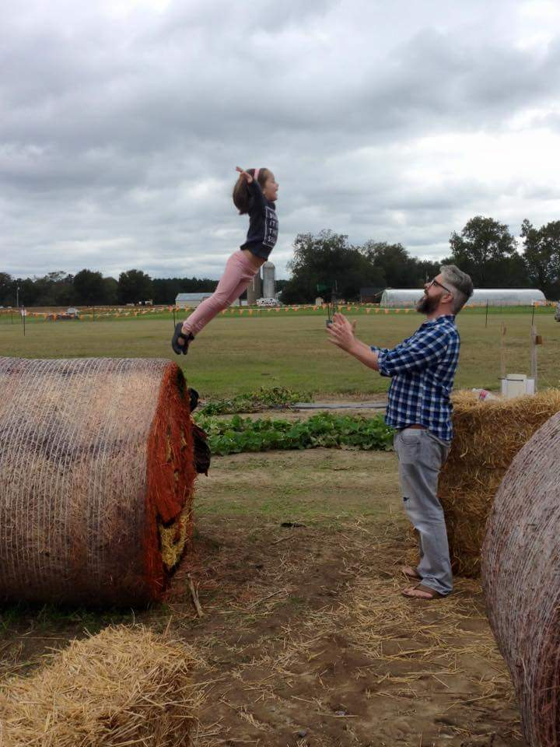
Trust
What does trust look like?
What does this photograph express about trust?
Is the girl the only one who is trusting in the picture?
Do you think the girl is wise? What helps you decide?
Do you think these people know each other well? Why might this be important?

Slide 13
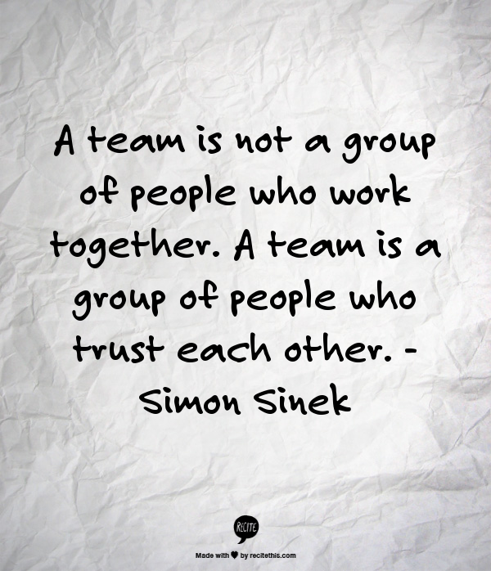
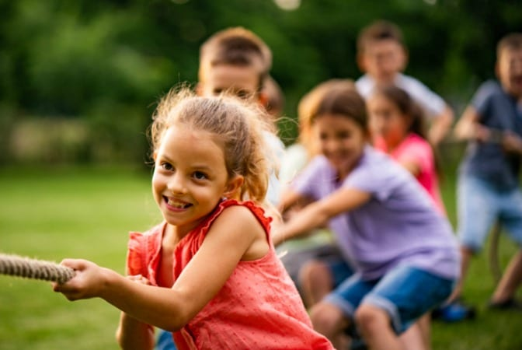
Trust
Do you agree with this statement?
How can a team of people trust each other?
What teams are you part of?
Think about how those teams could be built stronger.
What would happen if someone in
this team walked away?
Who, in this team, needs to be the most trustworthy?

Slide 14
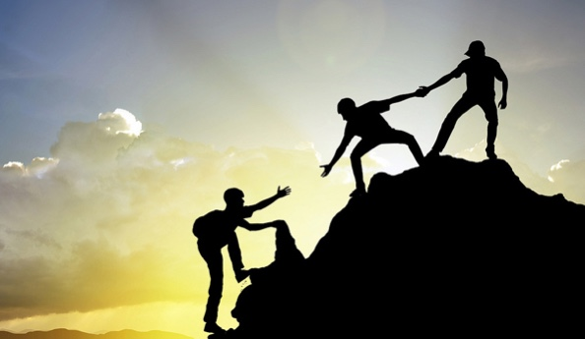
Friendship

Slide 15
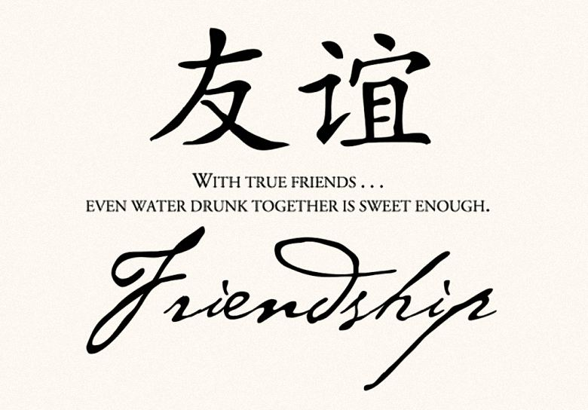
Friendship
What does the quote mean?
Look at the Chinese symbols. How do they show friendship?
What does friendship mean to you? Write your own quote starting ‘With true friends...’
Draw out one of the Chinese symbols and turn it into a picture of friends together

Slide 16
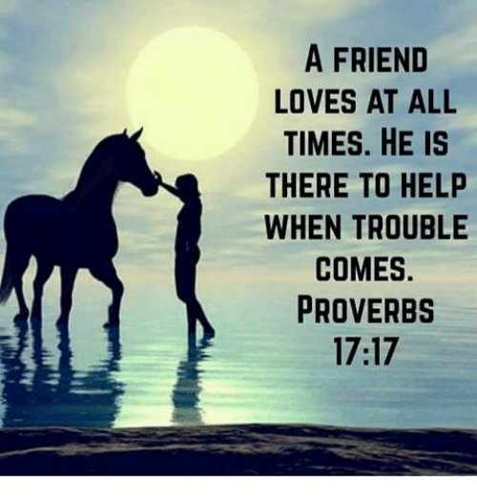
Friendship
This is a Christian proverb from the Bible. What do you think it means?
Can you think of any examples of when a true friend has helped you?
Can you think of times when you have helped a friend in need?
Do you think real friends have to know each other? Example: can we class the NHS as our friend?
Do you agree or disagree with the statement? Why/not?

Slide 17
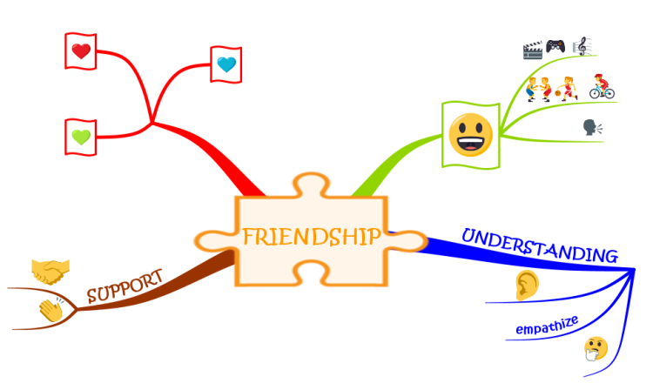
Friendship
Check out this friendship mind map
Make your own. Who and what will you include in the sections?
Can you extend yours with more or different aspects of friendship?
Use it to help you think about any ways you can be a better friend

Slide 18
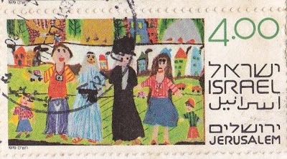
Friendship
Here is an Israeli stamp from the 1980s depicting friendship between Jews and Arabs. Often there are lots of tensions between these groups of people.
Think about what it would be like if the different people in the world, who are in conflict, made friends. What would the best things about that be?
How can we make a difference in our families, and other groups we are part of, by putting differences behind us?
Design your own stamp, depicting friendship. Challenge: show an area of friendship you find tricky
Write a letter to a friend
Think: is there someone you have held a grudge against? Can you let it go? What difference would it make?
Jot down your thoughts or responses, or draw your own picture of friendship

Slide 19
Friendship
Bruno Mars song, Count on me, has some thought provoking lyrics. Listen to the song or read the lyrics.
https://youtu.be/h9O5_Q-oLrs
Count on Me
Bruno Mars
If you ever find yourself stuck in the middle of the sea,
I'll sail the world to find you
If you ever find yourself lost in the dark and you can't see,
I'll be the light to guide you
Find out what we're made of
When we are called to help our friends in need
You can count on me like one two three
I'll be there
And I know when I need it I can count on you like four three two
You'll be there
'Cause that's what friends are supposed to do, oh yeah
Whoa, whoa
Oh, oh
Yeah, yeah
If you tossin' and you're turnin' and you just can't fall asleep
I'll sing a song
Beside you
And if you ever forget how much you really mean to me
Everyday I will
Remind you
Ooh
Find out what we're made of
When we are called to help our friends in need
You can count on me like one two three
Some of the language used is metaphoric. What kind of situation might it be describing by ‘stuck in the middle of the sea?
How does it help to ‘find out what we’re made of when we are called to help our friends in need’?
What do you agree with most or disagree with most in the song and why?
Can you write a verse to fit with the situation you and your friends are in right now?
What illustration would you make to go with your favourite bit of this song?

Slide 20
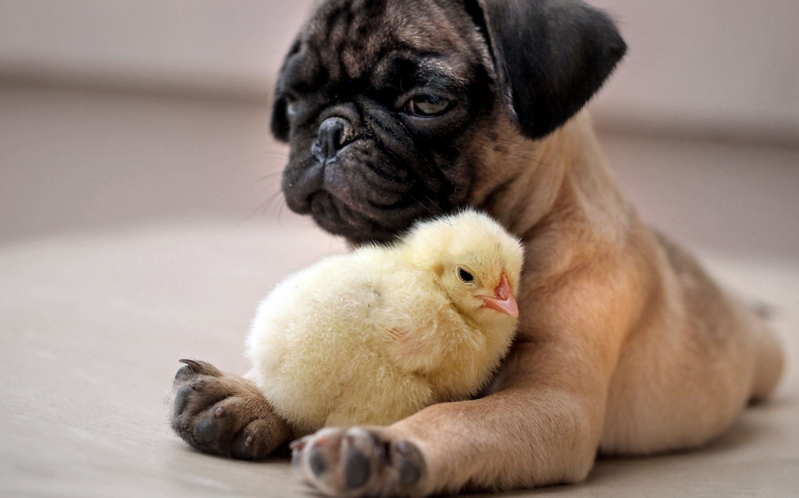
Friendship
What does this say to you about friendship?
How does this photo make you feel?
Does this remind you of your friendship with someone? Who is the happiest in this picture? Why?

Slide 21
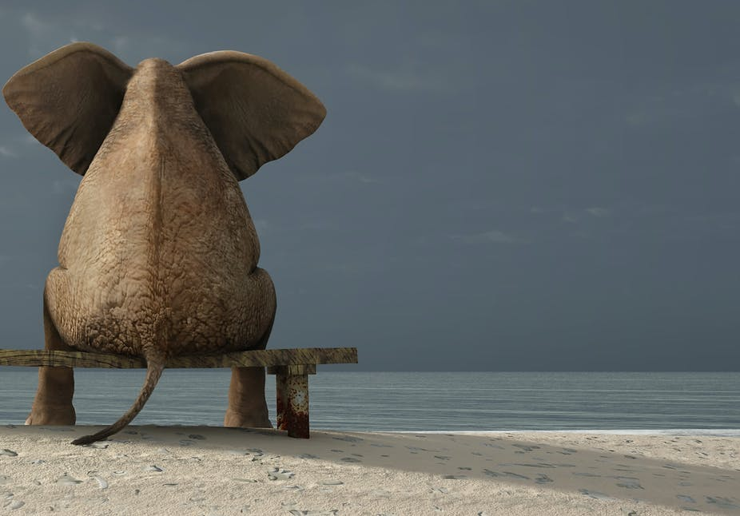
Forgiveness

Slide 22

Forgiveness
IT’S ONE OF THE GREATEST GIFTS YOU CAN GIVE YOURSELF, TO FORGIVE.
Maya Angelou
Do you agree or disagree with this statement? Why/not?
What might be in your gift boxes ready to be unwrapped, if you chose to forgive someone?
Doodle or draw things that might be released to you, if you choose to forgive.
Write a list of 20 reasons why people find it tricky to forgive
Look for other quotes about forgiveness. Copy them and illustrate them.
Think about the best way you can show forgiveness and decide what action, if any, you would like to take

Slide 23
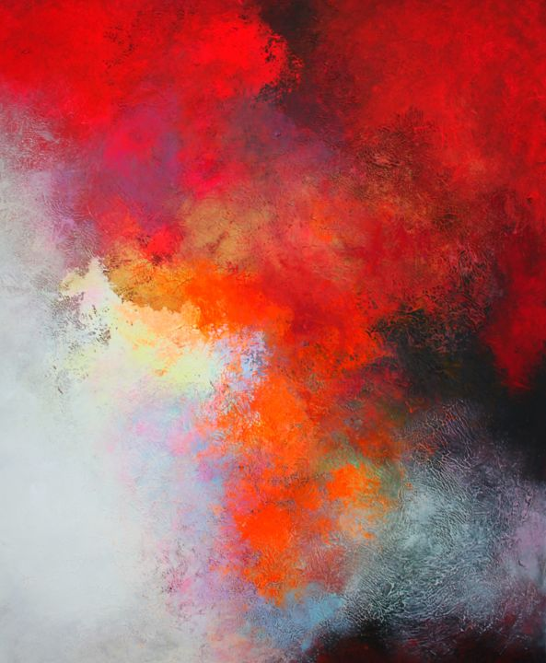
Forgiveness
This abstract piece of art by Alex Senchenco is called Forgiveness
Explore the painting. How does it connect with the act of forgiveness? How does it make you feel?
Write your responses (anything you want) about this painting and forgiveness.
Create your own abstract artwork or sculpture, which represents forgiveness.
Look up other art with the title ‘forgiveness’
Copy your favourite ‘forgiveness’ themed art and use it to inspire an acrostic poem of forgiveness

Slide 24
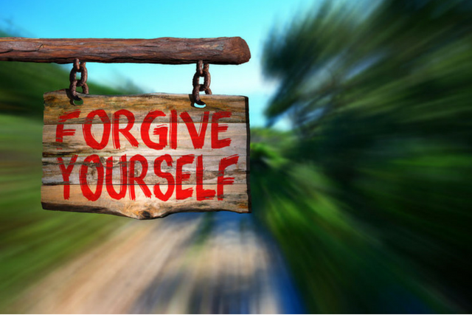
Forgiveness
Sometimes people find it tricky to forgive themselves. Why?
Do you think it is important to be able to forgive yourself?
How important do you think is self forgiveness for mental health?
How much does forgiveness affect our world? From 0-10?
Have a good think about if you have got anything that you could forgive yourself about
Make a poster to remind yourself or someone else to forgive themselves.

Slide 25
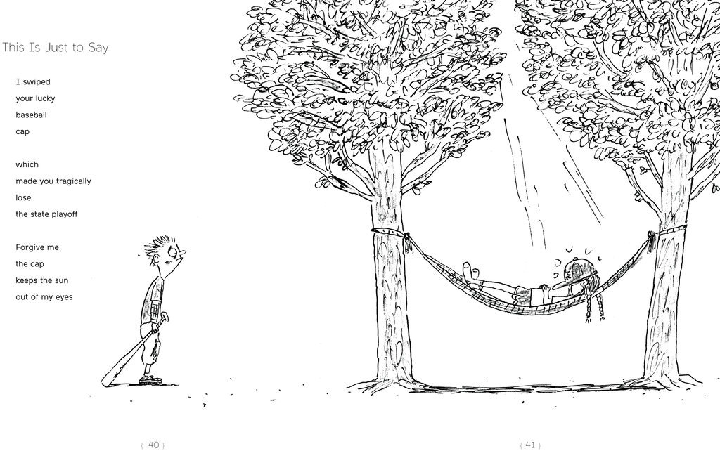
Forgiveness
In this poem do you think that the girl is truly sorry?
How do you feel when someone is not really sorry?
Do you think being truly sorry is important? Who does it benefit most?
Can we and should we forgive someone who is not truly sorry? Why/not?
Who gives us the right not to forgive?
If we have done things wrong ourselves how can we feel good about not forgiving someone else?
Credit...
From “Forgive Me, I Meant to Do It”

Slide 26
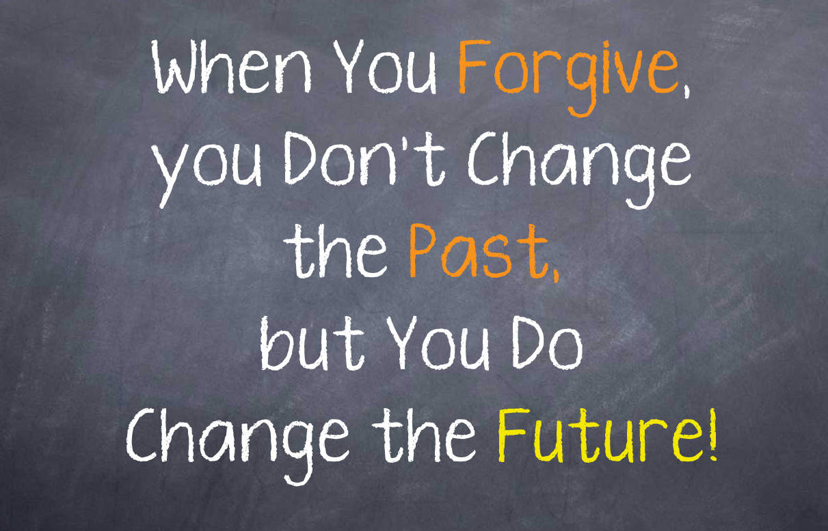
Forgiveness
The power of forgiveness
Read this statement and watc the video clip.
Do you agree with it, disagree or are you not sure?
Do you have any examples?
How does it affect the future if we don’t choose to forgive?
Respond any way you like to this statement in your reflective diary
Share your thoughts with family or friends
https://youtu.be/yXP6VqPygQE

Slide 27
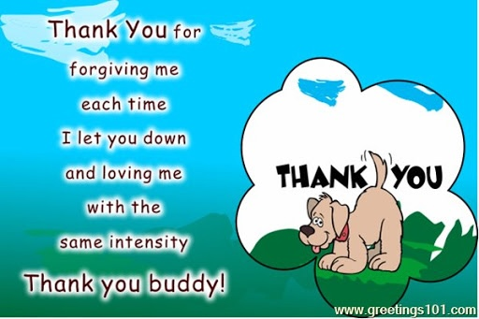
Forgiveness
Our pets are great at forgiving, sometimes even better than we are!
Why do you think our pets forgive us easily?
Do you remember times when you have been forgiven?
How do you feel when you have been forgiven?
How can we show appreciation for forgiveness?
Is there a way you can show someone your thanks for their forgiveness?
Respond to how you feel about being forgiven in your reflective diary
Create a thank you card for someone who has forgiven you.

Slide 28
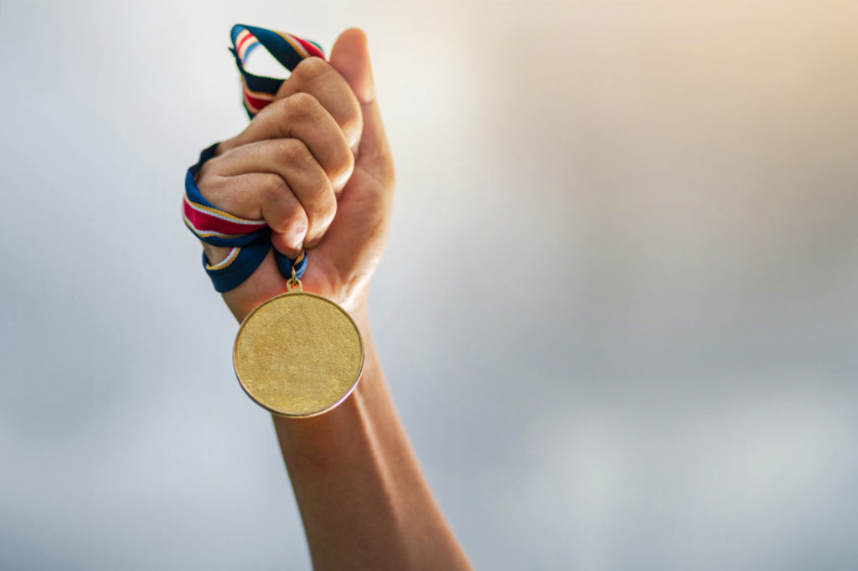
Determination

Slide 29
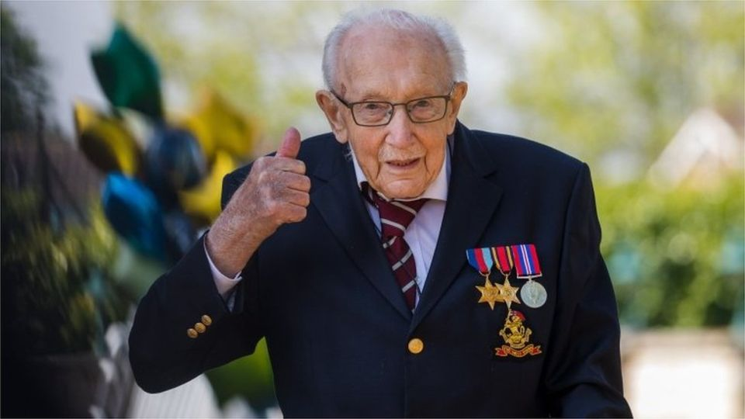
Determination
Captain Tom Moore was determined to walk 100 laps of his garden before his 100th Birthday to raise £1000 for the NHS. His determination helped him to raise lots more! Read about it in this article.
https://www.bbc.co.uk/newsround/52277760
Think about something you can do to make an improvement. Jot down your ideas. Be determined! Watch what happens.

Slide 30
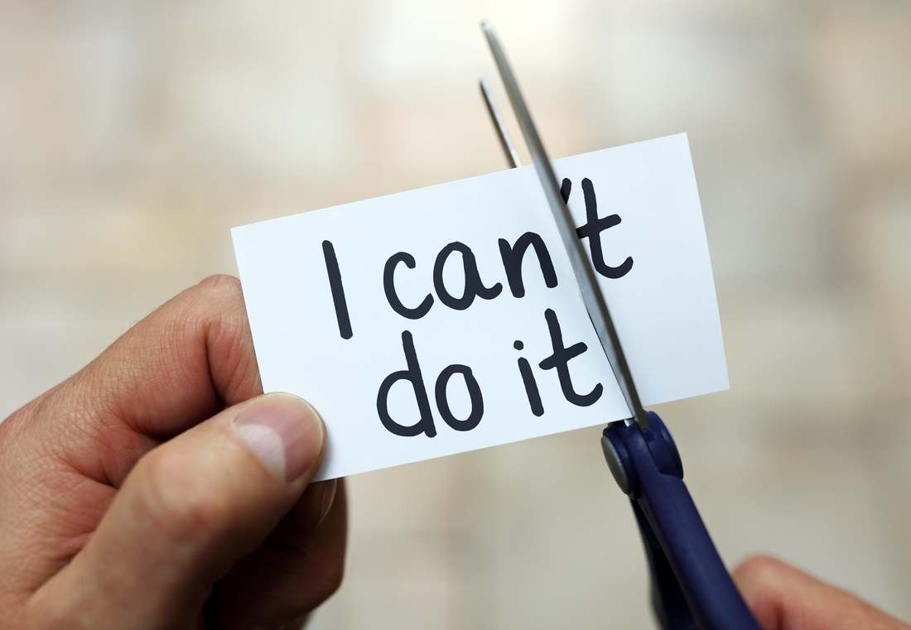
Determination
What has this got to do with determination?
Is determination ALWAYS a good thing? Why/not?
Is it possible to grow determination?
How do you react when people say you won’t be able to do something?
What can help you to keep going when you feel like giving up on something?

Slide 31
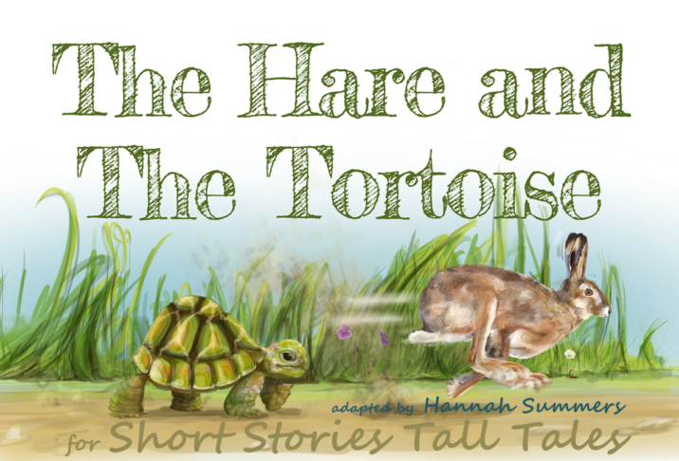
Determination
In this clip you can watch the story of The Hare and the Tortoise: https://youtu.be/nF1CnDFf9dA
Lists the strengths and weaknesses of both the characters in the story
Think about the importance of determination. What is it worth to you? How can it help you to reach your goals?

Slide 32
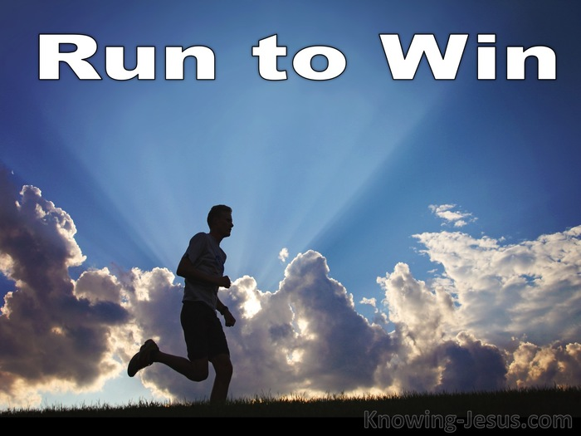
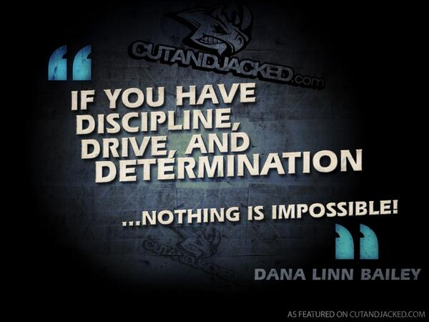
Determination
What do discipline and determination have to do with each other?
Athletes have to be disciplined to practise. How can that help them reach their goals?
What are you determined to achieve? What will you have to do to reach your goals?

Slide 33

Respect

Slide 34
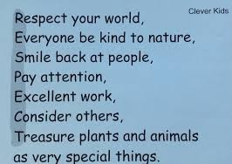
Respect
Here’s an acrostic poem about respect
Read the poem. Which line means the most to you about respect? Why?
Do you think that treasuring plants is part of being respectful?
What else do you think is important?
Write your own acrostic poem based on respect

Slide 35
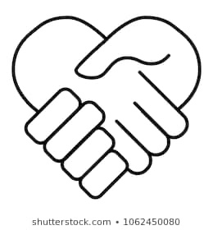
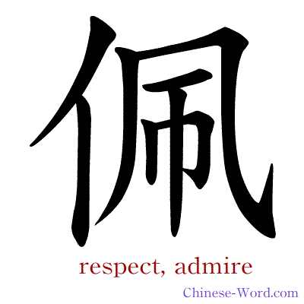



Respect
Each of the symbols, above, are symbols for respect. Which is the clearest? Why?
Look up a dictionary definition for respect
Create your own respect symbol
Think about different things that should be respected
Think about ways in which you can show your respect

Slide 36
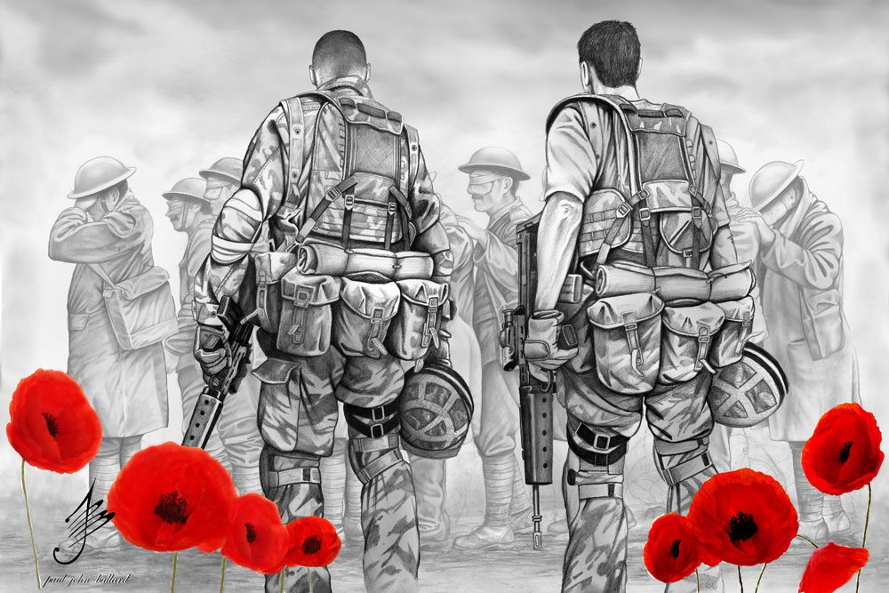
Respect
This artwork shows some modern day soldiers showing respect to the World War soldiers who fought in wars in the past. How can we tell?
Why do people still show respect by wearing poppies?
Create a respect drawing. You choose what the drawing will show respect to.

Slide 37
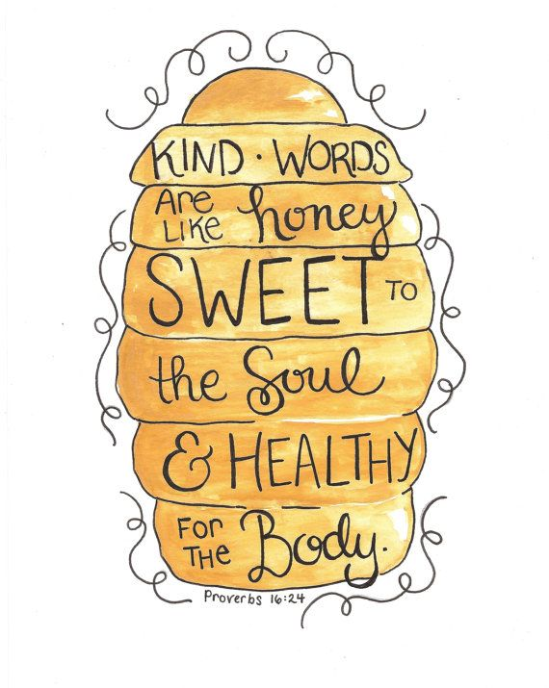
Respect
Being kind is one way of showing respect to others
How does it make you feel when others speak kindly to you?
How does it make you feel when unkind words are spoken about you?
Think about the members of your family. Write down kind words that you can say to them which will make them feel great. Take time to share those words with them today.

Slide 38
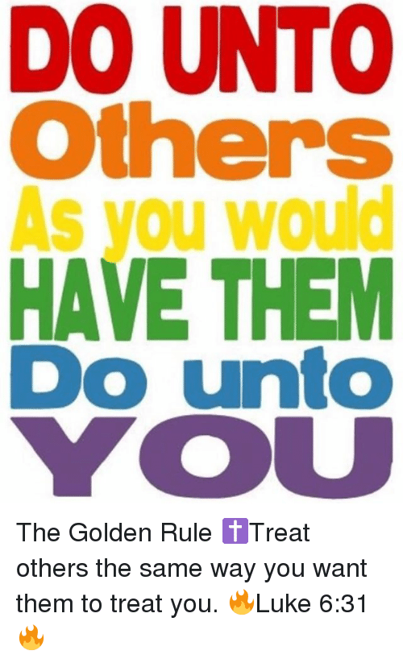
Respect
This golden rule comes from the Bible. Most religions have a very similar rule.
Re-write the rule in your own words.
Would you like it if others treated you kindly, with respect?
Think about how applying this rule would change the way you treat others
Watch the clip below to learn more about respect.
https://youtu.be/GOzrAK4gOSo

Slide 39
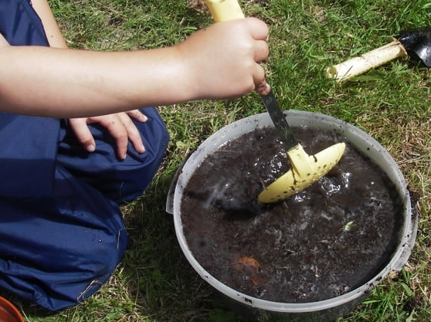
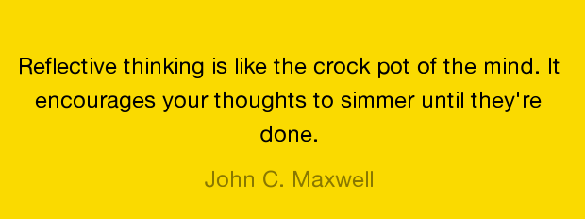
Creating your own reflection diary entries
If you have enjoyed creating a reflective diary or just having a reflective space where you can think and learn, why not continue? You don’t need pictures on here to help you. You can use anything at all that makes you think.
Some ideas for your own reflective diary
Excerpts from your reading book
A photograph you take of something that gets your attention
A moment in your day that is important to you
The internet. This diary has been created using inspiration from the internet. You will find lots and lots more!
Enjoy creating your own entries!

