Slide 1
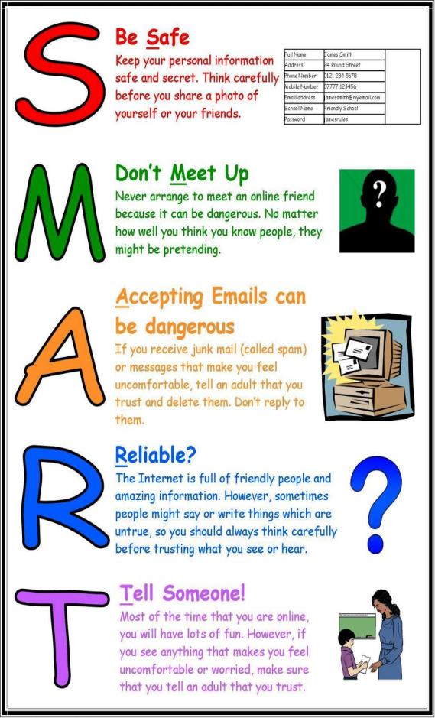
Staying Safe Online!
Stay safe rules:
I is for internet safety all around the word.
N is for not to use the internet in the wrong way.
T is for to do the right thing.
E is for E-safety.
R is for remembering to not cyber bully
N is for never go on social media under the appropriate age.
E is for everyone needs to stay safe.
T is for tell someone you trust.
Read this acrostic poem…

